Slide 1


JAVA Design Patterns (Simhadri Sai Krishna)

Slide 2
Agenda
Introduction
OO Concepts
Design Patterns
Types of Design Patterns
Design Pattern for Provider
Design pattern for Consumer
Notes:
JSP Training Session

Slide 3
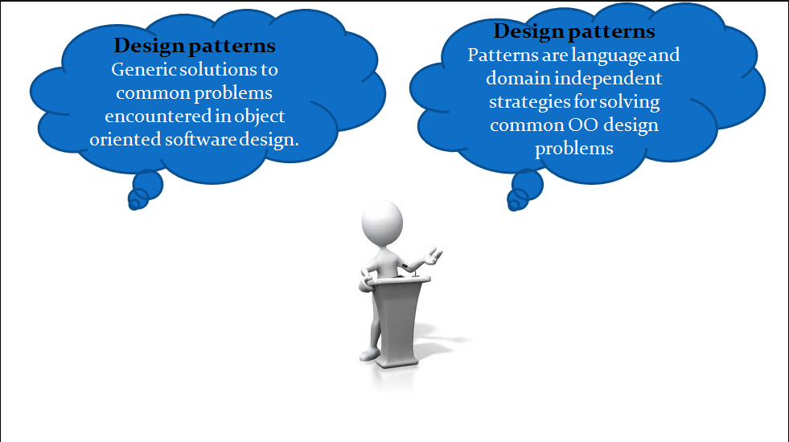
Introduction
Notes:
JSP Training Session

Slide 4
Introduction
Generic solutions to the common problems which are encounter in object oriented s/w design.
Design Patterns are language and domain independent. It is not only for S/w. it can be used in all the fields.
Design patterns are primarily based on the following principles of object orientated design.
• Program to an interface not an implementation
• Favor object composition over inheritance

Slide 5
Benefits of using Design Patterns
Design Patterns are already defined and provides industry standard approach to solve a recurring problem, so it saves time if we sensibly use the design pattern. There are many java design patterns that we can use in our java based projects.
Using design patterns promotes reusability that leads to more robust and highly maintainable code. It helps in reducing total cost of ownership (TCO) of the software product.
Since design patterns are already defined, it makes our code easy to understand and debug. It leads to faster development and new members of team understand it easily.

Slide 6
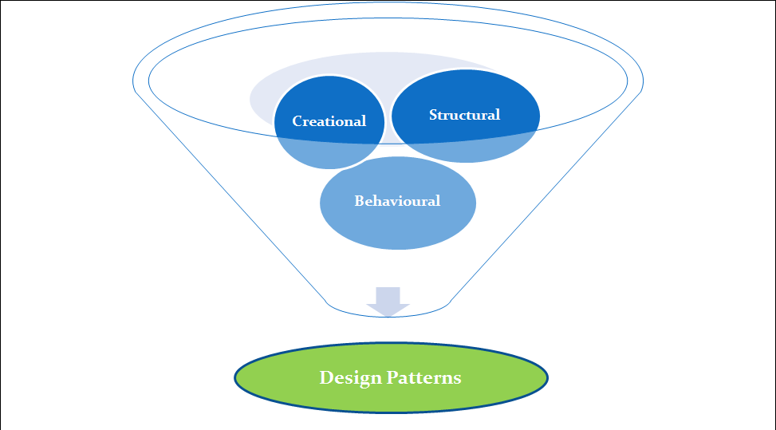
Types of Design Patterns

Slide 7
Types of Design Patterns
Creational design patterns provide solution to instantiate a object in the best possible way for specific situations. (5design Patterns)
Structural design patterns provide different ways to create a class structure, for example using inheritance and composition to create a large object from small objects (7 Design Patterns).
Behavioral design patterns provide solution for the better interaction between objects and how to provide lose coupling and flexibility to extend easily. (11 Design Patterns)
Advanced/Multiple design patterns

Slide 8
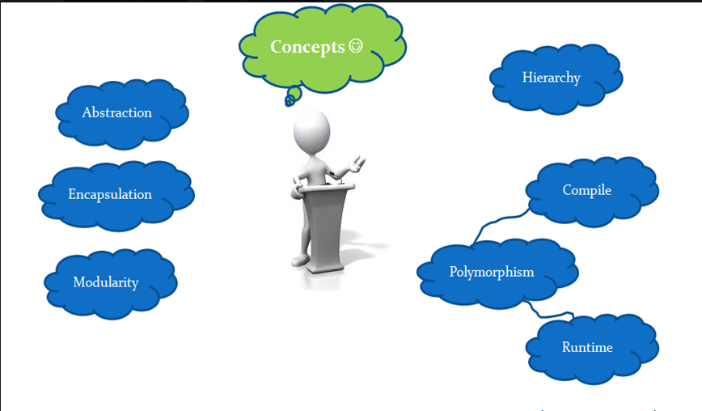
OO Concepts

Slide 9
OO Concepts
Abstraction: is hiding the information or providing only necessary details to the client.
Encapsulation: Wrapping up data member and method together into a single unit (i.e. Class) is called Encapsulation.
Modularity: Modularity is the property of a system that has been decomposed into a set of cohesive and loosely coupled modules.
Dividing n number of modules in projects. Each module loosely coupled
and work each module independently.
Hierarchy is the ranking or ordering of abstraction. Through hierarchy, a system can be made up of interrelated subsystems, which can have their own subsystems and so on until the smallest level components are reached. It uses the principle of “divide and conquer”. Hierarchy allows code reusability

Slide 10
OO Concepts
“IS–A” hierarchy : It defines the hierarchical relationship in inheritance, whereby from a super-class, a number of subclasses may be derived which may again have subclasses and so on . Ex- Rose “is–a” flower.
“PART–OF” hierarchy : It defines the hierarchical relationship in aggregation by which a class may be composed of other classes. Ex - Petal is a “part–of” flower.
Polymorphism: Polymorphism means to process objects differently based on their data type. Ex : All movable objects can move. Each object will move in a different way for same message.
Compile time polymorphism: types will be resolved at compile time.eg overloading and function templates.
Run time polymorphism: types will be resolved at run time. eg virtual functions

Slide 11
Design Pattern for Provider
Singleton pattern
Flyweight pattern
Factory Pattern
Data Access Object Pattern
Design Pattern for Consumer
MVC design pattern
Front Controller design pattern
DAO design pattern
Business Delegate Design Pattern

Slide 12
Singleton Design Pattern
There are only two points in the definition of a singleton design pattern
There should be only one instance allowed for a class and
We should allow global point of access to that single instance.
Ex: java.lang.Runtime, java.awt.Desktop.
Steps to make a class Singleton:
1. Create a class which you want to make Singleton
2. Create a private default constructor of the class.
3. Create a private static variable of the class created in step1.
and this variable should be private and static and it should refer to the instance of class created in step1.
4. Create a accessor method which could always return us back with a instance of class created in step 3.
5.There should not be any method or constructor which can create instance of this class.

Slide 13
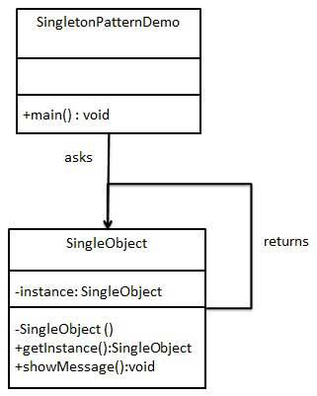
Singleton Design Pattern

Slide 14
Flyweight Design Pattern
Flyweight pattern is primarily used to reduce the number of objects created and to decrease memory footprint and increase performance. This type of design pattern comes under structural pattern as this pattern provides ways to decrease object count thus improving the object structure of application.
Flyweight pattern tries to reuse already existing similar kind objects by storing them and creates new object when no matching object is found. We will demonstrate this pattern by drawing 20 circles of different locations but we will create only 5 objects. Only 5 colors are available so color property is used to check already existing Circle objects.
Interface Shape
Concrete class Circle .
Factory class ShapeFactory
ShapeFactory has a HashMap of Circle having key as color of the Circle object. Whenever a request comes to create a circle of particular color to ShapeFactory, it checks the circle object in its HashMap, if object of Circle found, that object is returned otherwise a new object is created, stored in hashmap for future use, and returned to client.
FlyWeightPatternDemo, our demo class

Slide 15
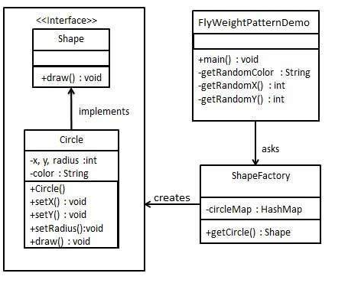
Flyweight Design Pattern

Slide 16
Factory Design Pattern
Factory design pattern is used when we have a super class with multiple sub-classes and based on input, we need to return one of the sub-class. This pattern take out the responsibility of instantiation of a class from client program to the factory class
When to use a Factory design pattern
When you don’t know ahead of time what class object you need
When all of the potential classes are in the same subclass hierarchy
To centralize class selection code
When you don’t want the user to have to know every subclass
To encapsulate object creation
It promotes the loose-coupling by eliminating the need to bind application-specific classes into the code.

Slide 17
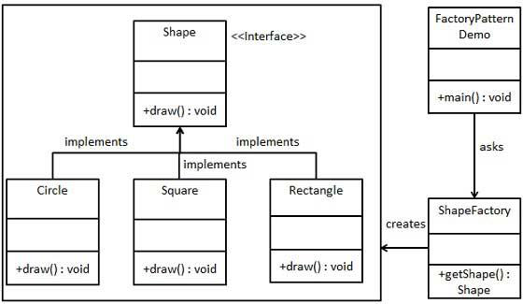
Factory Design Pattern

Slide 18
DATA ACCESS OBJECT PATTERN
Data Access Object Pattern or DAO pattern is used to separate low level data accessing API or operations from high level business services. Following are the participants in Data Access Object Pattern.
Business Layer → DAO → DB
DAO (CRUD) Operations.
• Data Access Object Interface - This interface defines the standard operations to be performed on a model object(s).
• Data Access Object concrete class - This class implements above interface. This class is responsible to get data from a data source which can be database / xml or any other storage mechanism.
• Model Object or Value Object - This object is simple POJO containing get/set methods to store data retrieved using DAO class.
Implementation:
We are going to create a Student object acting as a Model or Value Object.StudentDao is Data Access Object Interface. StudentDaoImpl is concrete class implementing Data Access Object Interface. DaoPatternDemo, our demo class, will use StudentDao to demonstrate the use of Data Access Object pattern.

Slide 19
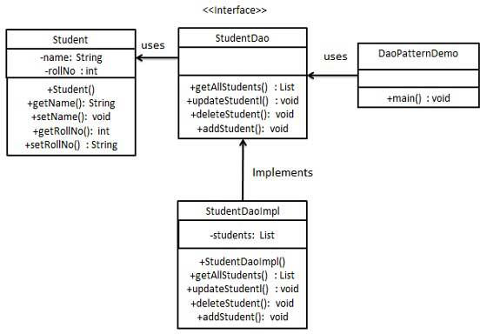

Slide 20
DATA TRANSFER OBJECT PATTERN
The Transfer Object pattern is used when we want to pass data with multiple attributes in one shot from client to server. Transfer object is also known as Value Object. Transfer Object is a simple POJO class having getter/setter methods and is serializable so that it can be transferred over the network. It does not have any behavior. Server Side business class normally fetches data from the database and fills the POJO and send it to the client or pass it by value. For client, transfer object is read-only. Client can create its own transfer object and pass it to server to update values in database in one shot. Following are the entities of this type of design pattern.
Business Object - Business Service fills the Transfer Object with data.
Transfer Object - Simple POJO having methods to set/get attributes only.
Client - Client either requests or sends the Transfer Object to Business Object.
Implementation
We are going to create a StudentBO as Business Object,Student as Transfer Object representing our entities.
TransferObjectPatternDemo, our demo class, is acting as a client here and will use StudentBO and Student to demonstrate Transfer Object Design Pattern.

Slide 21
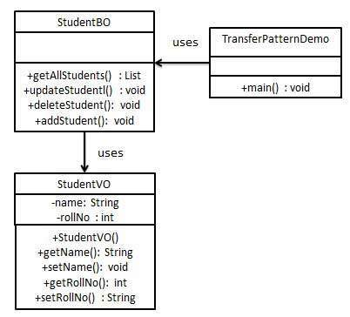

Slide 22
MVC PATTERN
MVC Pattern stands for Model-View-Controller Pattern. This pattern is used to separate application's concerns.
• Model (JDBC, HIBERNATE) - Model represents an object or JAVA POJO carrying data. It can also have logic to update controller if its data changes.
• View (JSP, HTML, CSS)- View represents the visualization of the data that model contains.
• Controller(JSP/Servlet) - Controller acts on both model and view. It controls the data flow into model object and updates the view whenever data changes. It keeps view and model separate.
Implementation:
We are going to create a Student object acting as a model. StudentView will be a view class which can print student details on console and StudentController is the controller class responsible to store data in Student object and update view StudentView accordingly.
MVCPatternDemo, our demo class, will use StudentController to demonstrate use of MVC pattern.

Slide 23
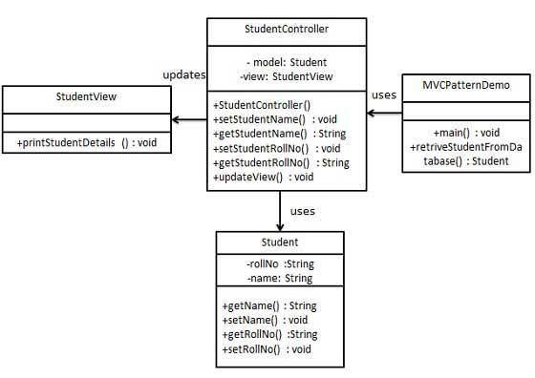

Slide 24
FRONT CONTROLLER PATTERN
The front controller design pattern is used to provide a centralized request handling mechanism so that all requests will be handled by a single handler. This handler can do the authentication/ authorization/ logging or tracking of request and then pass the requests to corresponding handlers. Following are the entities of this type of design pattern.
• Front Controller - Single handler for all kinds of requests coming to the application (either web based/ desktop based).
• Dispatcher - Front Controller may use a dispatcher object which can dispatch the request to corresponding specific handler.
• View - Views are the object for which the requests are made.
Implementation
We are going to create a FrontController and Dispatcher to act as Front Controller and Dispatcher correspondingly. HomeView and StudentView represent various views for which requests can come to front controller.
FrontControllerPatternDemo, our demo class, will use FrontController to demonstrate Front Controller Design Pattern.

Slide 25
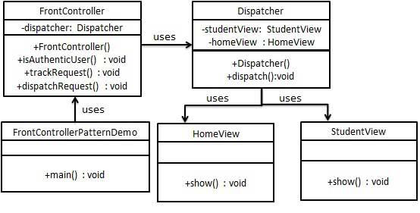

Slide 26
BUSINESS DELEGATE PATTERN
Business Delegate Pattern is used to decouple presentation tier and business tier. It is basically use to reduce communication or remote lookup functionality to business tier code in presentation tier code. In business tier we have following entities.
• Client - Presentation tier code may be JSP, servlet or UI java code.
• Business Delegate - A single entry point class for client entities to provide access to Business Service methods.
• LookUp Service - Lookup service object is responsible to get relative business implementation and provide business object access to business delegate object.
• Business Service - Concrete classes implement this business service to provide actual business implementation logic.
Implementation
We are going to create a Client, BusinessDelegate, BusinessService, LookUpService, JMSService and EJBService representing various entities of Business Delegate patterns.
BusinessDelegatePatternDemo, our demo class, will use BusinessDelegate and Client to demonstrate use of Business Delegate pattern.

Slide 27
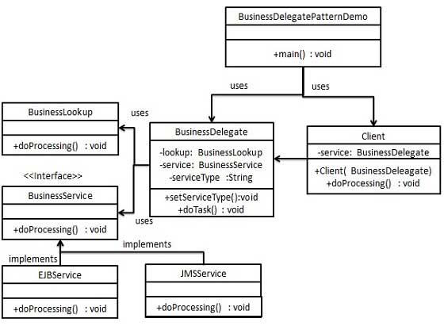

Slide 28
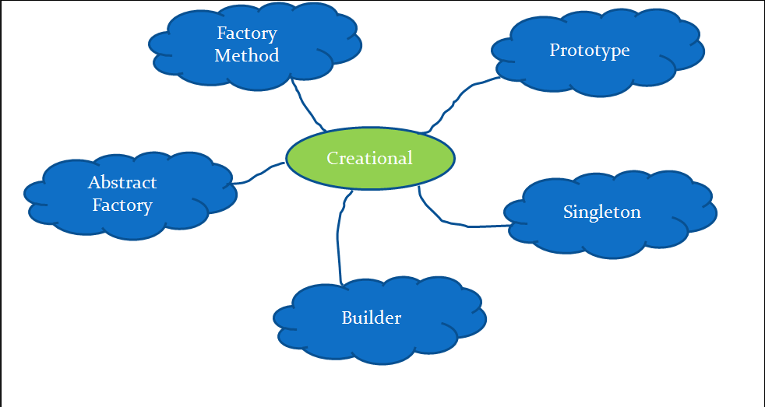
Creational Design Patterns
“solution to instantiate a object in the best possible way for specific situations.”

Slide 29
Abstract Factory Design Pattern
Abstract Factory patterns work around a super-factory which creates other factories. This factory is also called as factory of factories. This type of design pattern comes under creational pattern as this pattern provides one of the best ways to create an object.
In Abstract Factory pattern an interface is responsible for creating a factory of related objects without explicitly specifying their classes. Each generated factory can give the objects as per the Factory pattern.
Advantage of Abstract Factory Pattern
Abstract Factory Pattern isolates the client code from concrete (implementation) classes.
It eases the exchanging of object families.
It promotes consistency among objects.

Slide 30
Abstract Factory Design Pattern
Usage of Abstract Factory Pattern
When the system needs to be independent of how its object are created, composed, and represented.
When the family of related objects has to be used together, then this constraint needs to be enforced.
When you want to provide a library of objects that does not show implementations and only reveals interfaces.
When the system needs to be configured with one of a multiple family of objects.
Interface: Shape and Color interfaces
Concrete classes Circle, Rectangle, Square, Red, Green, Blue
Abstract factory class AbstractFactory
Factory classes ShapeFactory and ColorFactory
A factory creator/generator class FactoryProducer
AbstractFactoryPatternDemo, our demo class.

Slide 31
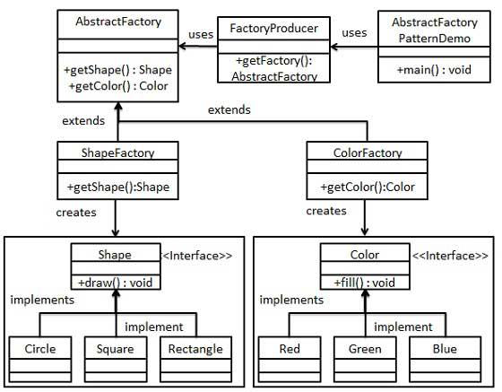
Abstract Factory Design Pattern

Slide 32
Prototype Design Pattern
Prototype says that cloning of an existing object instead of creating new one and can also be customized as per the requirement
This pattern involves implementing a prototype interface which tells to create a clone of the current object.
This pattern is used when creation of object directly is costly.
Advantage of Prototype Pattern
The main advantages of prototype pattern are as follows:
It reduces the need of sub-classing.
It hides complexities of creating objects.
The clients can get new objects without knowing which type of object it will be.
Usage of Prototype Pattern
When the classes are instantiated at runtime.
When the cost of creating an object is expensive or complicated.
When you want to keep the number of classes in an application minimum.
When the client application needs to be unaware of object creation and representation.

Slide 33
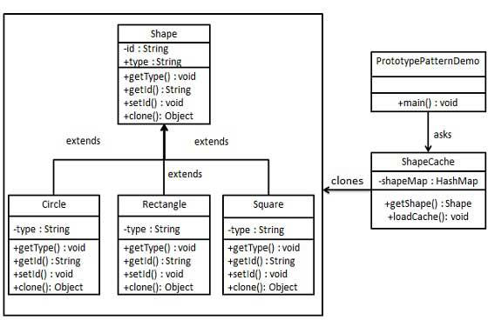
Prototype Design Pattern

Slide 34
Builder Design Pattern
It construct a complex object from simple objects using step-by-step approach
Helps to build objects in parts and separates object construction from its representation.
when you want to have many classes help in the creation of an object. By having different classes build the object you can then easily create many different types of objects without being forced to rewrite code.
Advantage of Builder Design Pattern
The main advantages of Builder Pattern are as follows:
It provides clear separation between the construction and representation of an object.
It provides better control over construction process.
It supports to change the internal representation of objects.
We have considered a business case of fast-food restaurant where a typical meal could be a burger and a cold drink. Burger could be either a Veg Burger or Chicken Burger and will be packed by a wrapper. Cold drink could be either a coke or pepsi and will be packed in a bottle.

Slide 35
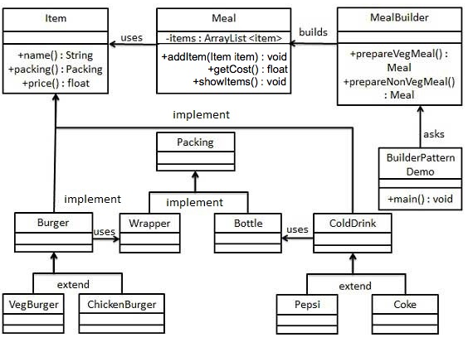
Builder Design Pattern

Slide 36
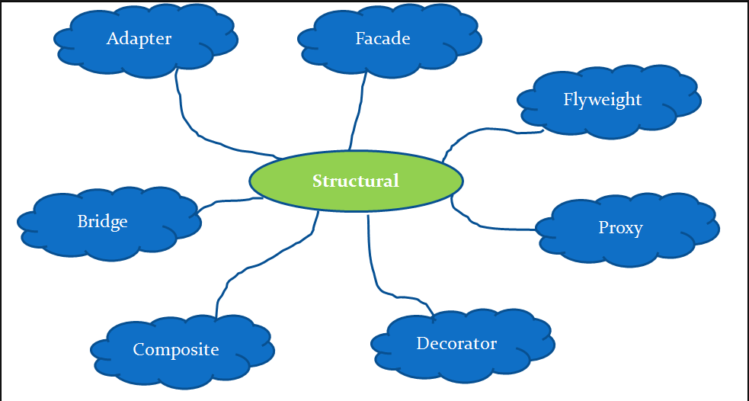
Structural Design Patterns
“Provide different ways to create a class structure, for example using inheritance and composition to create a large object from small objects.”

Slide 37
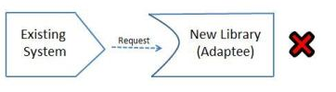
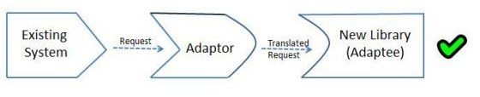
Adapter Design Pattern
Adapter pattern works as a bridge between two incompatible interfaces. This type of design pattern comes under structural pattern as this pattern combines the capability of two independent interfaces.
This pattern involves a single class which is responsible to join functionalities of independent or incompatible interfaces.

Slide 38
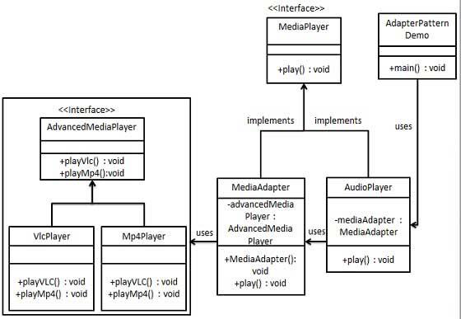
Adapter Design Pattern

Slide 39
Bridge Design Pattern
Bridge is used when we need to decouple an abstraction from its implementation so that the two can vary independently .
This pattern decouples implementation class and abstract class by providing a bridge structure between them.
We have a DrawAPI interface which is acting as a bridge implementer and concrete classes RedCircle, GreenCircle implementing the DrawAPI interface. Shape is an abstract class and will use object of DrawAPI. BridgePatternDemo, our demo class, will use Shape class to draw different colored circle.
Advantages of Bridge Pattern
It enables the separation of implementation from the interface.
It improves the extensibility
It allows the hiding of implementation details from the client

Slide 40
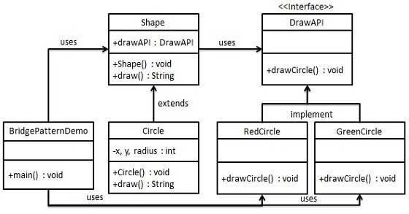
Bridge Design Pattern

Slide 41
Composite Design Pattern
Composite pattern is used where we need to treat a group of objects in similar way as a single object .
Composite pattern composes objects in term of a tree structure to represent part as well as whole hierarchy
We have a class Employee which acts as composite pattern actor class. CompositePatternDemo, our demo class, will use Employee class to add department level hierarchy and print all employees.
Advantage of Composite Pattern
It defines class hierarchies that contain primitive and complex objects.
It makes easier to you to add new kinds of components
It provides flexibility of structure with manageable class or interface.

Slide 42
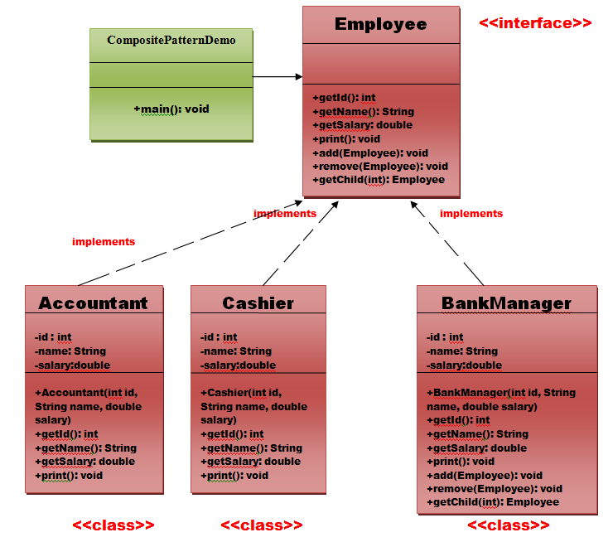
Composite Design Pattern

Slide 43
Decorator Design Pattern
Decorator pattern allows a user to add new functionality to an existing object without altering its structure
This pattern creates a decorator class which wraps the original class and provides additional functionality keeping class methods signature intact.
Advantage of Decorator Pattern
It provides greater flexibility than static inheritance.
It enhances the extensibility of the object, because changes are made by coding new classes.
It simplifies the coding by allowing you to develop a series of functionality from targeted classes instead of coding all of the behavior into the object.
Usage of Decorator Pattern
When you want to transparently and dynamically add responsibilities to objects without affecting other objects.
When you want to add responsibilities to an object that you may want to change in future.
Extending functionality by sub-classing is no longer practical.

Slide 44
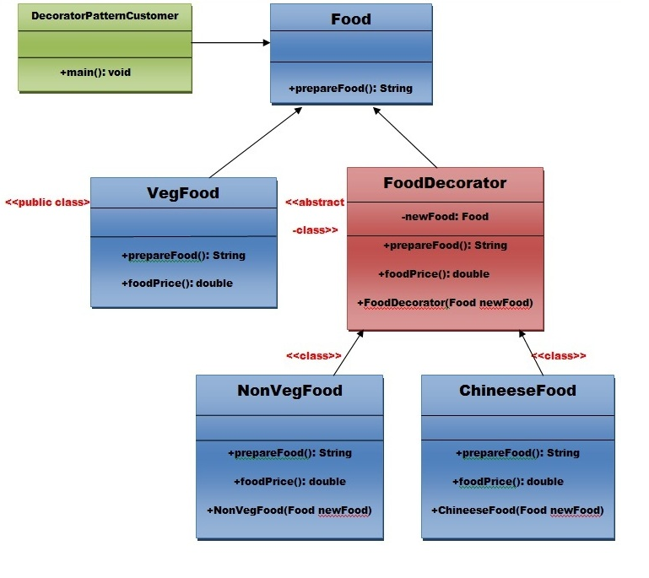
Decorator Design Pattern

Slide 45
Façade Design Pattern
Facade as the name suggests means the face of the building.
Facade pattern hides the complexities of the system and provides an interface to the client using which the client can access the system.
E.g.: Event Manger (Decoration, Food, Invitations, Music troop).
OnlineBookOrder:
Advantage of Facade Pattern
It shields the clients from the complexities of the sub-system components.
It promotes loose coupling between subsystems and its clients.
Usage of Facade Pattern:
When you want to provide simple interface to a complex sub-system.
When several dependencies exist between clients and the implementation classes of an abstraction.
Interface Shape and concrete classes Circle, Rectangle, Square.
Facade class ShapeMaker, FacadePatternDemo, our demo class

Slide 46
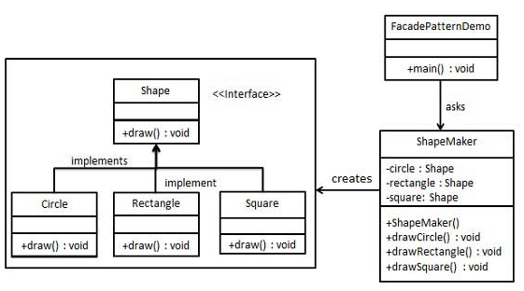
Façade Design Pattern

Slide 47
Proxy Design Pattern
Simply, proxy means an object representing another object.
According to GoF, a Proxy Pattern "provides the control for accessing the original object".
So, we can perform many operations like hiding the information of original object, on demand loading etc.
RMI API uses proxy design pattern. Stub and Skeleton are two proxy objects used in RMI.
Advantage of Proxy Pattern
It provides the protection to the original object from the outside world.
Provides additional layer of security
Authorization layer to verify that whether the actual user has access the appropriate content or not.
To avoid multiple database call

Slide 48
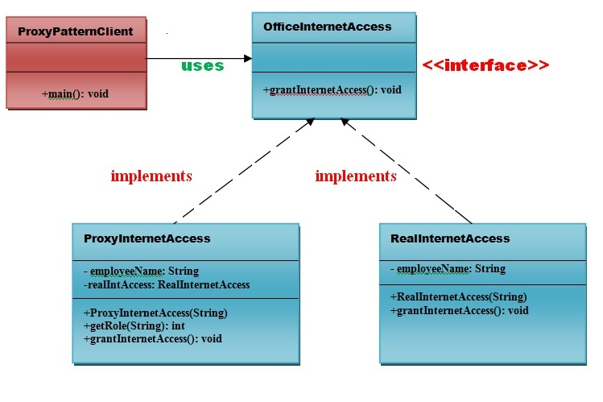
Proxy Design Pattern

Slide 49
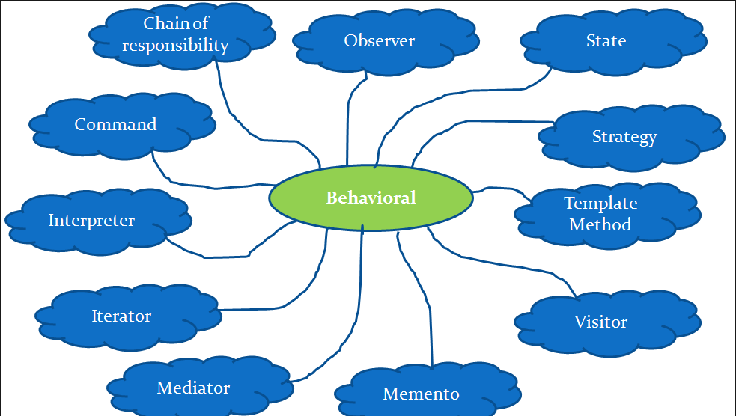
Behavioral Design Patterns
“Provide solution for the better interaction between objects and how to provide lose coupling and flexibility to extend easily.”

Slide 50
Chain of Responsibility Design Pattern
As the name suggests, the chain of responsibility pattern creates a chain of receiver objects for a request i.e. "avoid coupling the sender of a request to its receiver by giving multiple objects a chance to handle the request"
This pattern decouples sender and receiver of a request based on type of request
Advantages of Chain of Responsibility Pattern
It reduces the coupling.
It adds flexibility while assigning the responsibilities to objects.
It allows a set of classes to act as one; events produced in one class can be sent to other handler classes with the help of composition.

Slide 51
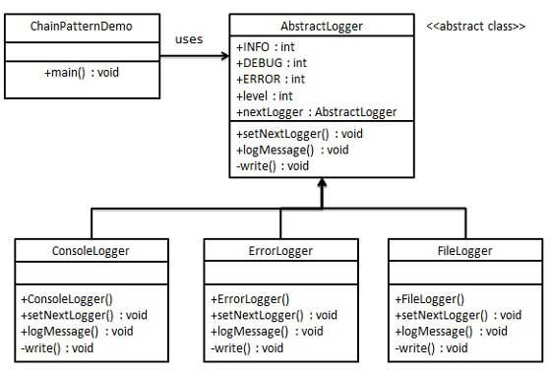
Chain of Responsibility Design Pattern

Slide 52
Command Design Pattern
Command pattern is a data driven design pattern
A request is wrapped under an object as command and passed to invoker object. Invoker object looks for the appropriate object which can handle this command and passes the command to the corresponding object which executes it.
Advantage of command pattern
It separates the object that invokes the operation from the object that actually performs the operation.
It makes easy to add new commands, because existing classes remain unchanged

Slide 53
Command Design Pattern
We have concrete command classes BuyStock and SellStock implementing Order interface which will do actual command processing. A class Broker is created which acts as an invoker object. It can take and place orders.
Broker object uses command pattern to identify which object will execute which command based on the type of command. CommandPatternDemo, our demo class, will use Broker class to demonstrate command pattern.

Slide 54
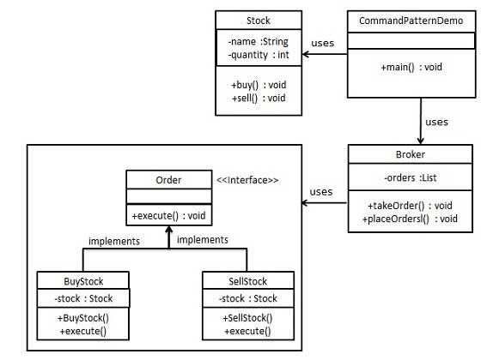
Command Design Pattern

Slide 55
Iterator Design Pattern
Iterator pattern is very commonly used design pattern in Java and .Net programming environment. This pattern is used to get a way to access the elements of a collection object in sequential manner without any need to know its underlying representation.
Iterator pattern falls under behavioral pattern category.
We're going to create a Iterator interface which narrates navigation method and aContainer interface which returns the iterator . Concrete classes implementing theContainer interface will be responsible to implement Iterator interface and use it
IteratorPatternDemo, our demo class will use NamesRepository, a concrete class implementation to print a Names stored as a collection in NamesRepository.

Slide 56
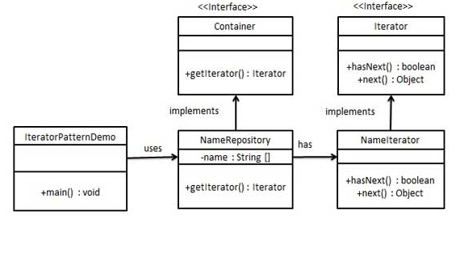
Iterator Design Pattern

Slide 57
State Design Pattern
In State pattern a class behavior changes based on its state. This type of design pattern comes under behavior pattern.
In State pattern, we create objects which represent various states and a context object whose behavior varies as its state object changes.
We are going to create a State interface defining an action and concrete state classes implementing the State interface. Context is a class which carries a State.
StatePatternDemo, our demo class, will use Context and state objects to demonstrate change in Context behavior based on type of state it is in.

Slide 58
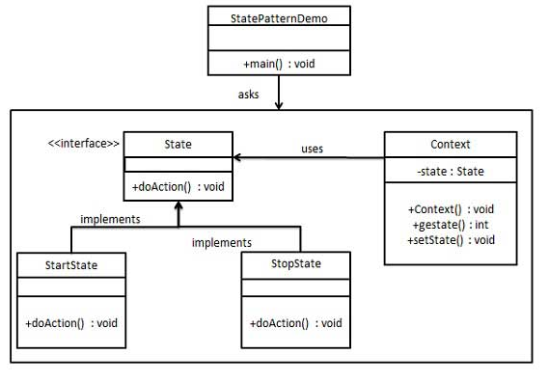
State Design Pattern

Slide 59
Mediator Design Pattern
Mediator pattern is used to reduce communication complexity between multiple objects or classes .
This pattern provides a mediator class which normally handles all the communications between different classes and supports easy maintenance of the code by loose coupling.
We are going to demonstrate mediator pattern by example of a chat room where multiple users can send message to chat room and it is the responsibility of chat room to show the messages to all users.
User objects will use ChatRoom method to share their messages.
MediatorPatternDemo, our demo class, will use User objects to show communication between them.

Slide 60
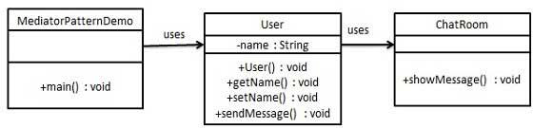
Mediator Design Pattern

Slide 61
Momento Design Pattern
Memento pattern is used to restore state of an object to a previous state.
Memento pattern uses three actor classes.
Memento contains state of an object to be restored. Originator creates and stores states in Memento objects and Caretaker object is responsible to restore object state from Memento
MementoPatternDemo, our demo class, will use CareTaker and Originator objects to show restoration of object states.

Slide 62
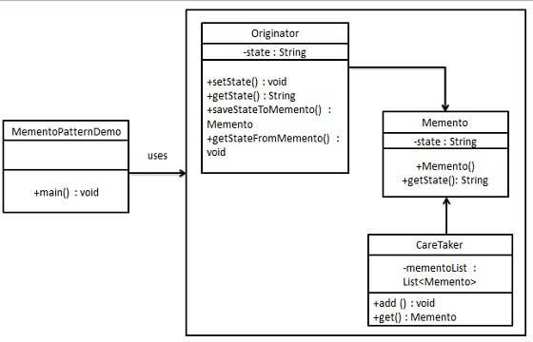
Momento Design Pattern

Slide 63
Observer Design Pattern
Observer pattern is used when there is one-to-many relationship between objects such as if one object is modified, its dependent objects are to be notified automatically.
Observer pattern uses three actor classes. Subject, Observer and Client.
Subject is an object having methods to attach and detach observers to a client object.
ObserverPatternDemo, our demo class, will use Subject and concrete class object to show observer pattern in action. .

Slide 64
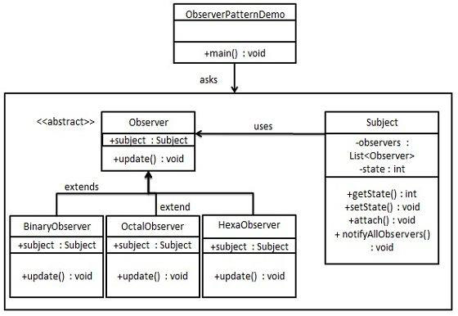
Observer Design Pattern

Slide 65
Strategy Design Pattern
In Strategy pattern, a class behavior or its algorithm can be changed at run time.
In Strategy pattern, we create objects which represent various strategies and a context object whose behavior varies as per its strategy object.
The strategy object changes the executing algorithm of the context object .
Create a Strategy interface defining an action and concrete strategy classes implementing the Strategy interface. Context is a class which uses a Strategy.
StrategyPatternDemo, our demo class, will use Context and strategy objects to demonstrate change in Context behaviour based on strategy it deploys or uses

Slide 66
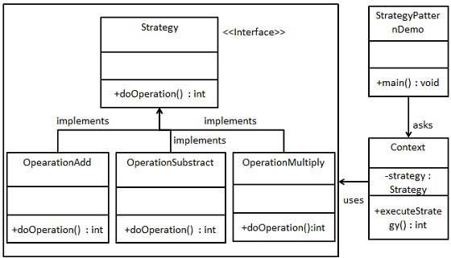
Strategy Design Pattern

Slide 67
Template Design Pattern
In Template pattern, an abstract class defines way(s)/template(s) to execute its methods.
Its subclasses can override the method implementation as per need but the invocation is to be in the same way as defined by an abstract class.
Create a Game abstract class defining operations with a template method set to be final so that it cannot be overridden .
Cricket and Football are concrete classes that extend Game and override its methods .
TemplatePatternDemo, our demo class, will use Game to demonstrate use of template pattern .

Slide 68
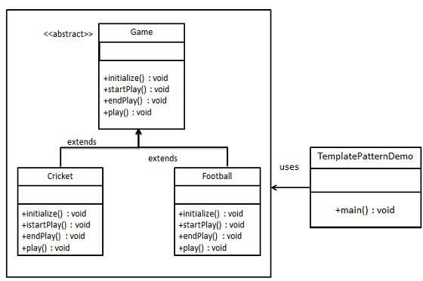
Template Design Pattern

Slide 69
Visitor Design Pattern
Visitor pattern actually does is create an external class that uses data in the other classes.
If you need to perform operations across a dispate set of objects, Visitor might be the pattern for you.
In Visitor pattern, we use a visitor class which changes the executing algorithm of an element class.
By this way, execution algorithm of element can vary as and when visitor varies.
As per the pattern, element object has to accept the visitor object so that visitor object handles the operation on the element object .
Create a ComputerPart interface defining accept operation. Keyboard, Mouse, Monitor, and Computer are concrete classes implementing ComputerPart interface .
Another interface ComputerPartVisitor which will define a visitor class operations. Computer uses concrete visitor to do corresponding action.
VisitorPatternDemo, our demo class, will use Computer and ComputerPartVisitor classes to demonstrate use of visitor pattern .

Slide 70
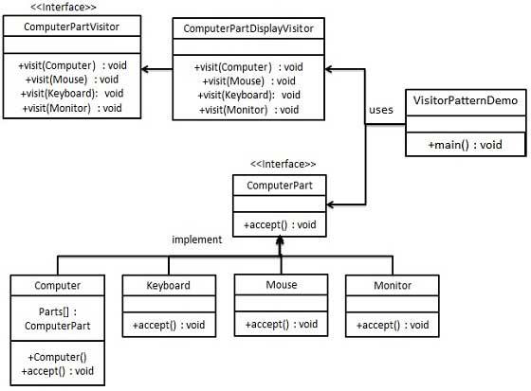
Visitor Design Pattern

Slide 71
Visitor Pattern Can be Used in following Scenarios
The pattern should be used when you have distinct and unrelated operations to perform across a structure of objects.
You may want to run operations against a set of objects with different interfaces.
Visitors are also valuable if you have to perform a number of unrelated operations across the classes.
The following example shows a simple implementation of the pattern in Java. The example we'll use here is a postage system. Our set of elements will be the items in our shopping cart. Postage will be determined using the type and the weight of each item, and of course depending on where the item is being shipped to.
Let's create a seperate visitor for each postal region. This way, we can seperate the logic of calculating the total postage cost from the items themselves. This means that our individual elements don't need to know anything about the postal cost policy, and therefore, are nicely decoupled from that logic.

Slide 72
Thank You

